Slide 1
Syslog – SNMP – NTP – DNS

Slide 2
Implementing Log Messaging
  Routers should be configured to send log messages to one or more of these:
    Console
    Terminal lines
    Memory buffer
    SNMP traps
    Syslog
  Syslog logging is a key security policy component.

Slide 3
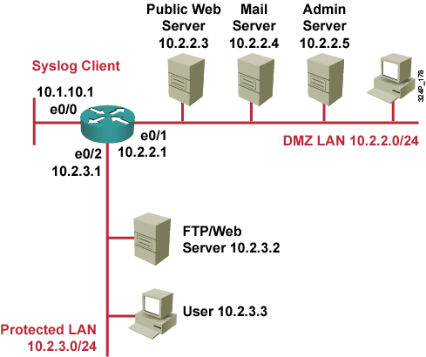
Syslog Systems
  Syslog server: A host that accepts and processes log messages from one or more syslog clients.
  Syslog client: A host that generates log messages and forwards them to a syslog server.

Slide 4
Cisco Log Severity Levels
Level
Name
Description
0
Emergencies
Router unusable
1
Alerts
Immediate action required
2
Critical
Condition critical
3
Errors
Error condition
4
Warnings
Warning condition
5
Notifications
Normal but important event
6
Informational
Informational message
7
Debugging
Debug message

Slide 5
Log Message Format
Time Stamp
Message Text
Oct 29 10:00:01 EST: %SYS-5-CONFIG_I: Configured from console by vty0 (10.2.2.6)
Log Message Name and Severity Level

Slide 6

Configuring Syslog Logging

Slide 7
Configuring Syslog
Router(config)#
logging [host-name | ip-address]
  Sets the destination logging host
Router(config)#
logging trap level
  (Optional) Sets the log severity (trap) level

Slide 8
Configuring Syslog (Cont.)
Router(config)#
logging source-interface interface-type interface-number
  (Optional) Sets the source interface
Router(config)#
logging on
  Enables logging

Slide 9
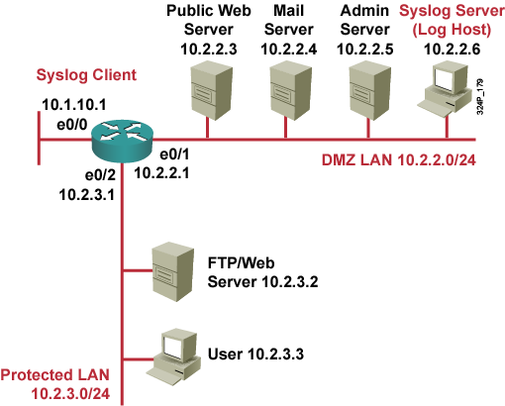
Syslog Implementation Example
R3(config)#logging 10.2.2.6
R3(config)#logging trap informational
R3(config)#logging source-interface loopback 0
R3(config)#logging on

Slide 10
SNMP

Slide 11
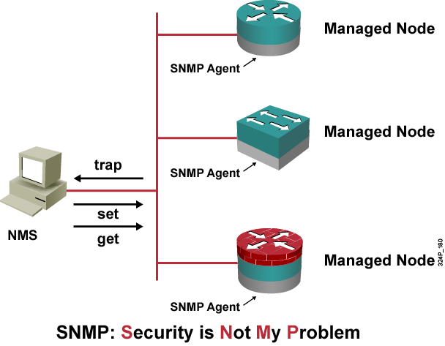
SNMPv1 and SNMPv2 Architecture
  The SNMP NMS asks agents embedded in network devices for information, or tells the agents to do something.

Slide 12
Community Strings
Used to authenticate messages between a management station, and an SNMPv1 or SNMPv2 engine:
  Read only community strings can get information, but can not set information in an agent.
  Read-write community strings can get and set information in the agent.
  Having read-write access is like having the enable password for the device.

Slide 13
SNMP Security Models and Levels
Definitions:
  Security model is a security strategy used by the SNMP agent
  Security level is the permitted level of security within a security model
Model | Level | Authentication | Encryption | What Happens
v1 | noAuthNoPriv | Community String | No | Authenticates with a community string match
v2 | noAuthNoPriv | Community String | No | Authenticates with a community string match
v3 | noAuthNoPriv | Username | No | Authenticates with a username
 | authNoPriv | MD5 or SHA | No | Provides HMAC MD5 or SHA algorithms for authentication
 | authPriv | MD5 or SHA | DES | Provides HMAC MD5 or SHA algorithms for authentication Provides DES 56-bit encryption in addition to authentication based on the CBC-DES (DES-56) standard

Slide 14
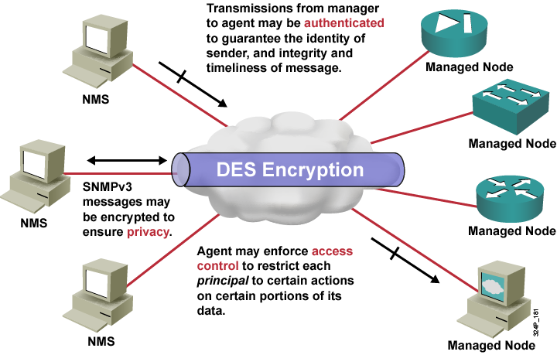
SNMPv3 Architecture

Slide 15
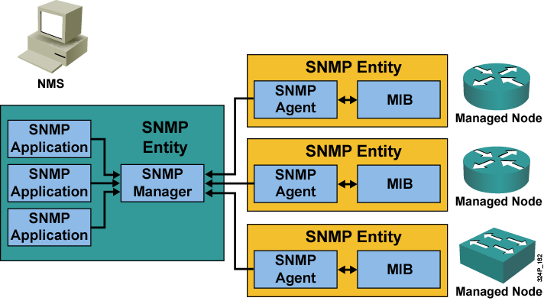
SNMP Operational Model

Slide 16
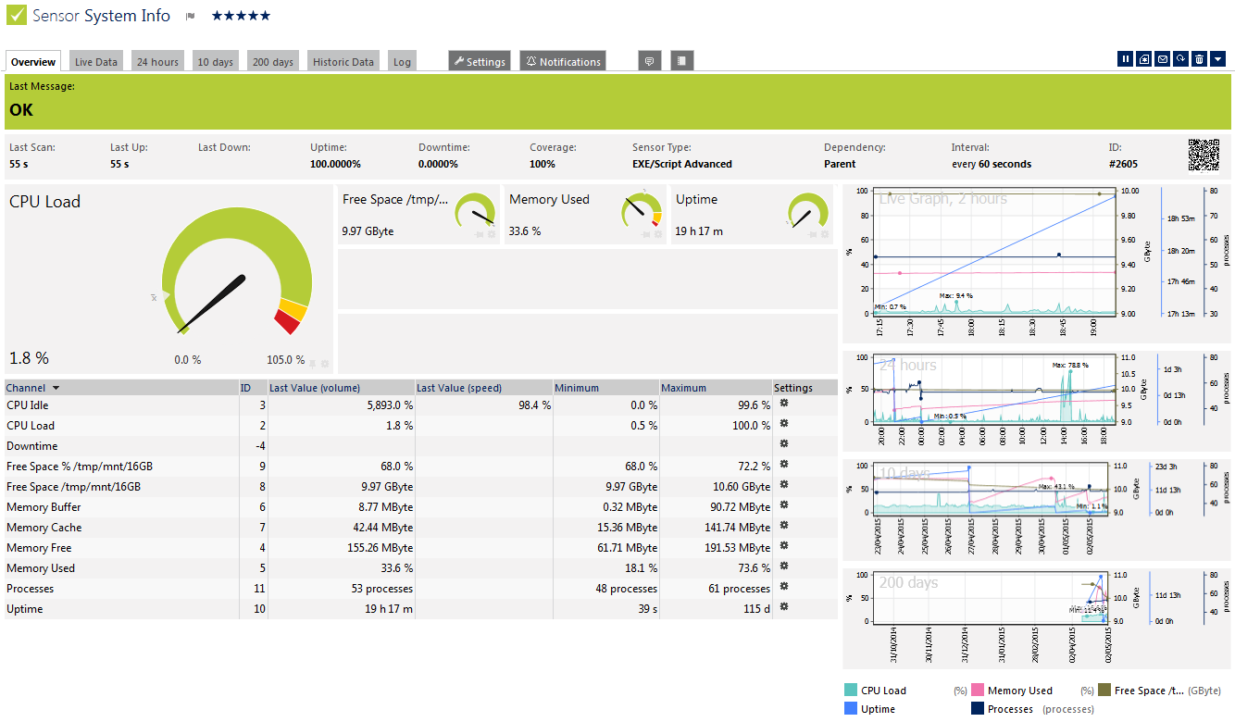

Example

Slide 17
Configuring NTP Client

Slide 18
Understanding NTP
  NTP is used to synchronize the clocks in the entire network.
  System clock is set by the battery system calendar during bootup.
  System clock can then be modified manually or via NTP.
  NTP runs over UDP port 123; current version is 4.
  Only NTP up to version 3 has been documented in RFCs.
  Stratum describes how many “NTP hops” away a machine is from authoritative time source.
  NTP establishes associations to synchronize time.

Slide 19
Configuring NTP Associations
Router(config)#
ntp server {ip-address | hostname} [version number] [key keyid] [source interface] [prefer]
Forms a server association with another system

Slide 20
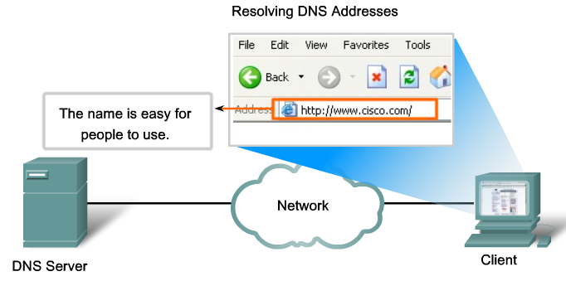
Domain Name Server - DNS

Slide 21
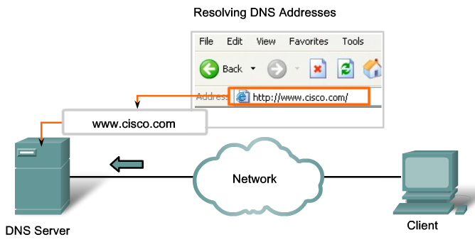
Domain Name Server - DNS

Slide 22
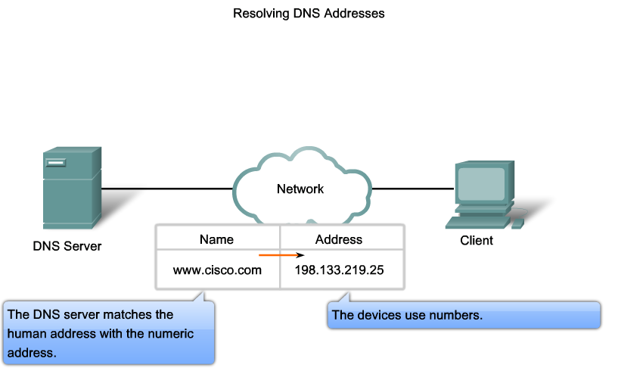
Domain Name Server - DNS

Slide 23
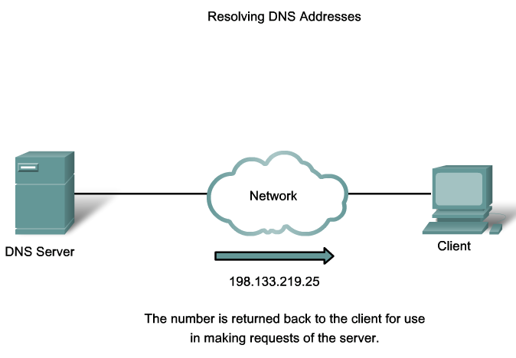
Domain Name Server - DNS

Slide 24
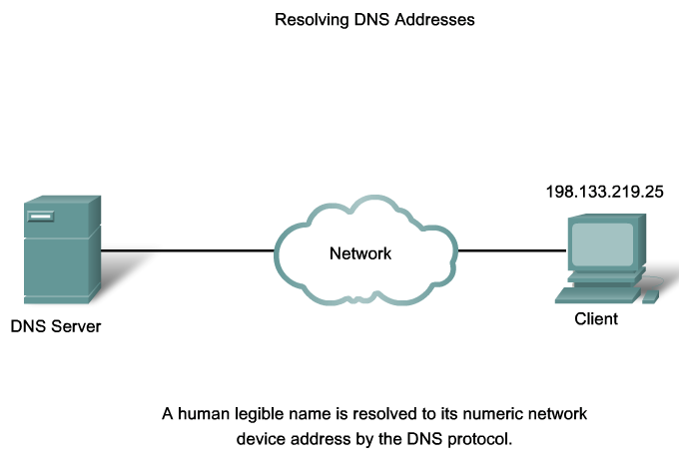
Domain Name Server - DNS

Slide 25
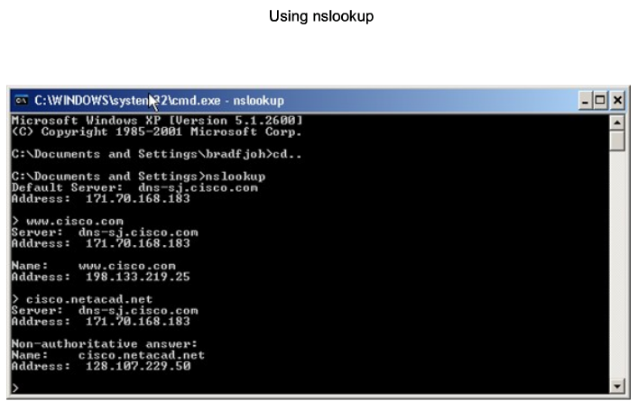
Domain Name Server - DNS

Slide 26
Introduction to IP QoS
Introducing QoS

Slide 27
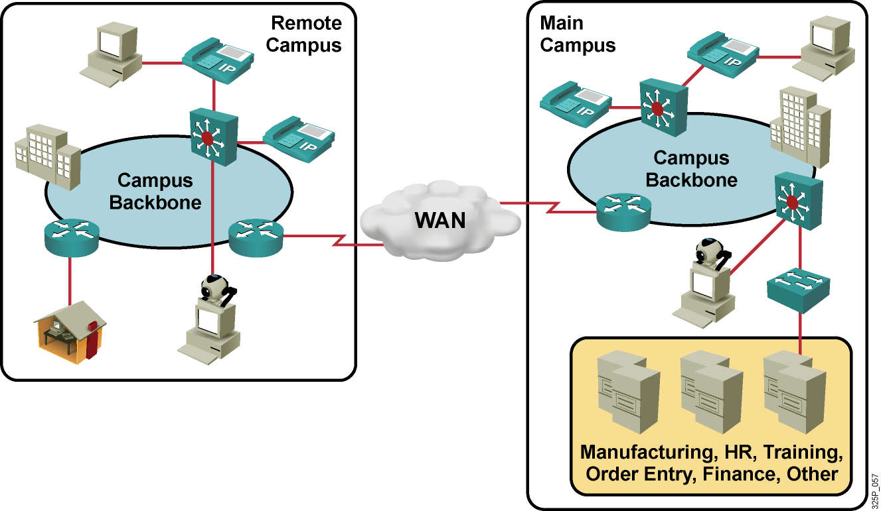
Converged Network Quality Issues
Converged traffic characteristics:
  Constant small-packet voice flow competes with bursty data flow.
  Critical traffic must get priority.
  Voice and video are time-sensitive.
  Brief outages are not acceptable.

Slide 28
Converged Network Quality Issues (Cont.)
  Lack of bandwidth: Multiple flows compete for a limited amount of bandwidth.
  End-to-end delay (fixed and variable): Packets have to traverse many network devices and links that add up to the overall delay.
  Variation of delay (jitter): Sometimes there is a lot of other traffic, which results in increased delay.
  Packet loss: Packets may have to be dropped when a link is congested.

Slide 29
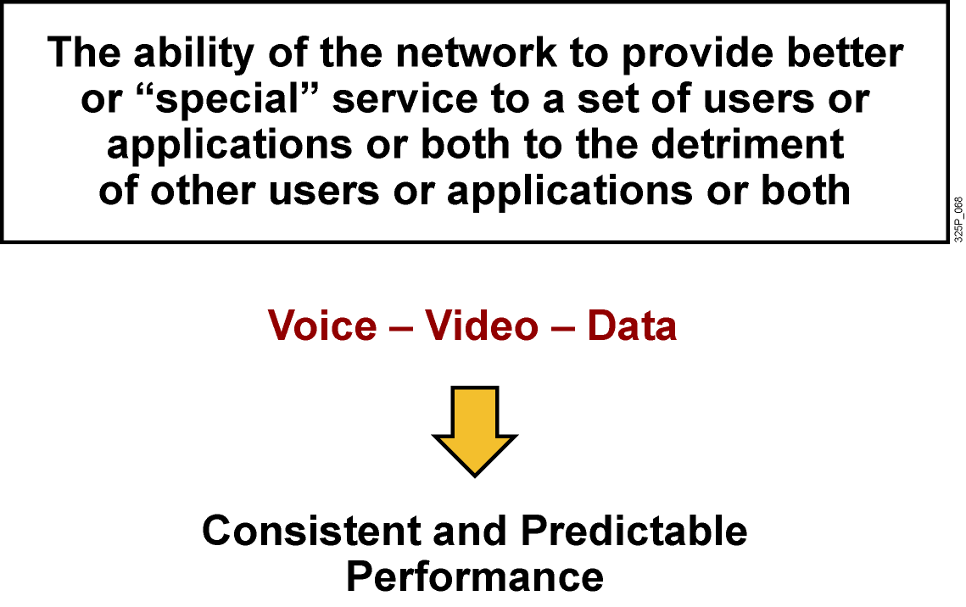
QoS Defined

Slide 30
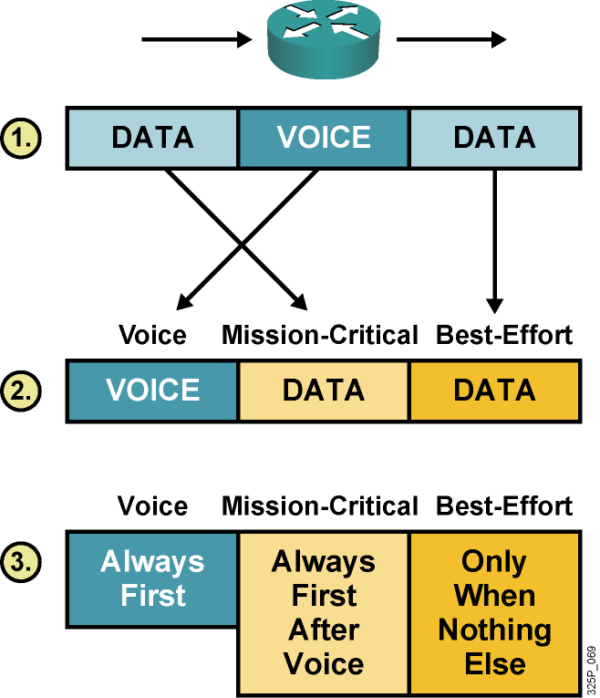
Implementing QoS
  Identify traffic and its requirements.
  Divide traffic into classes.
  Define QoS policies for each class.

Slide 31
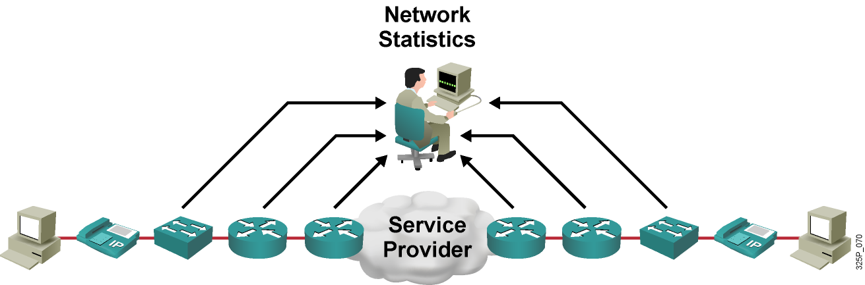
Identify Traffic and Its Requirements
  Network audit: Identify traffic on the network.
  Business audit: Determine how important each type of traffic is for business.
  Service levels required: Determine required response time.

Slide 32
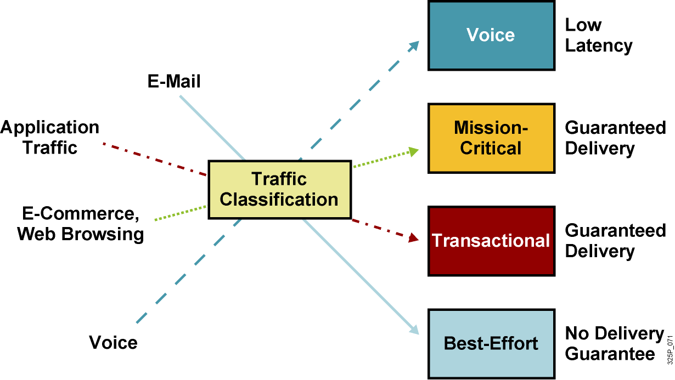
The Requirements of Different Traffic Types

Slide 33
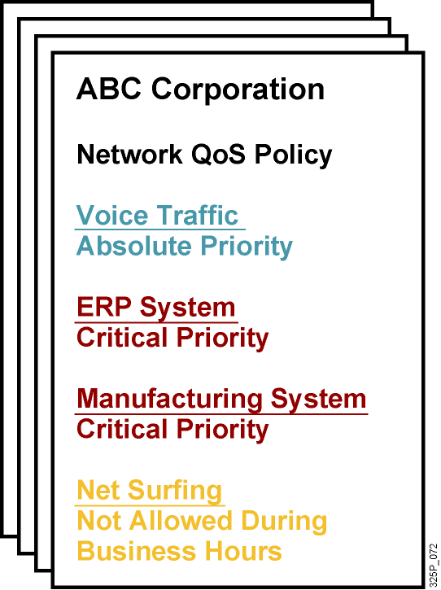
QoS Policy
  A networkwide definition of the specific levels of QoS assigned to different classes of network traffic

Slide 34
Classification
  Classification is the process of identifying and categorizing traffic into classes, typically based upon:
    Incoming interface
    IP precedence
    DSCP
    Source or destination address
    Application
  Classification is the most fundamental QoS building block.
  Without classification, all packets are treated the same.

Slide 35
Marking
  Marking is the QoS feature component that “colors” a packet (frame) so it can be identified and distinguished from other packets (frames) in QoS treatment.
  Commonly used markers:
    Link layer:
      CoS (ISL, 802.1p)
      MPLS EXP bits
      Frame Relay
    Network layer:
      DSCP
      IP precedence

Slide 36
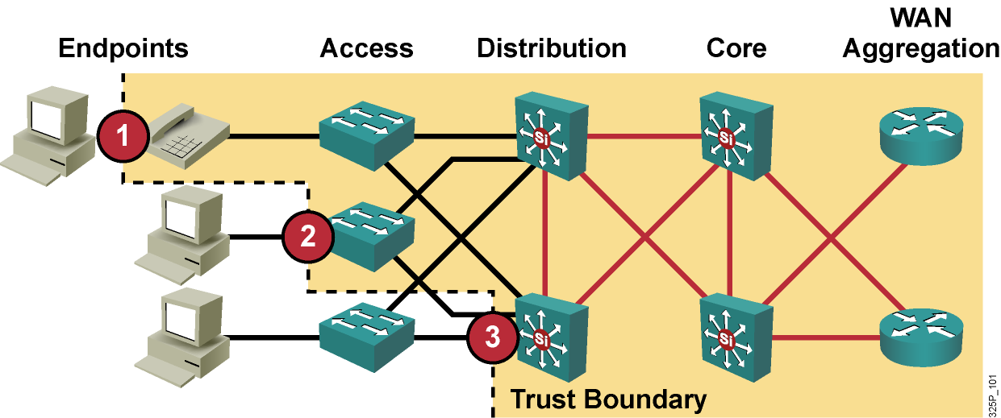
Trust Boundaries: Classify Where?
For scalability, classification should be enabled as close to the edge as possible, depending on the capabilities of the device at:
  Endpoint or end system
  Access layer
  Distribution layer

Slide 37
Implementing QoS Policy
Using a QoS Service Class

Slide 38
Implementing QoS Policy Using a QoS Service Class (Cont.)
  Profile applications to their basic network requirements.
  Do not overengineer provisioning; use no more than four to five traffic classes for data traffic:
    Voice applications: VoIP
    Mission-critical applications: Oracle, SAP, SNA
    Interactive applications: Telnet, TN3270
    Bulk applications: FTP, TFTP
    Best-effort applications: E-mail, WWW
    Scavenger applications: Nonorganizational streaming and video applications
  Do not assign more than three applications to mission-critical or transactional classes.
  Use proactive policies before reactive (policing) policies.
  Seek executive endorsement of relative ranking of application priority prior to rolling out QoS policies for data.

Slide 39
Implement the DiffServ QoS Model
Introducing Queuing Implementations

Slide 40
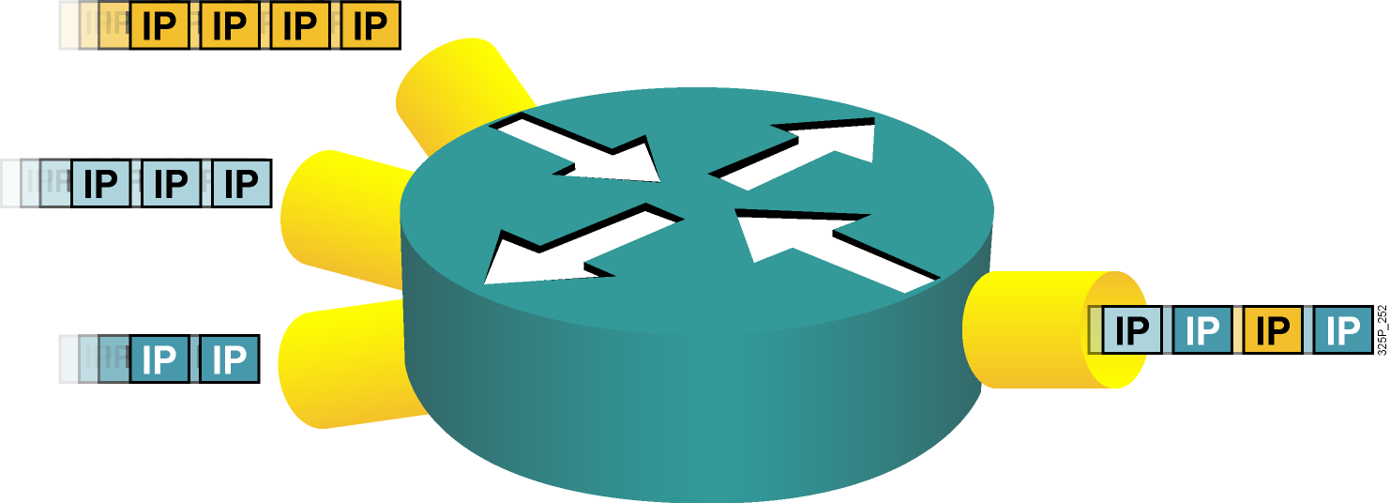
Congestion and Queuing
  Congestion can occur at any point in the network where there are points of speed mismatches or aggregation.
  Queuing manages congestion to provide bandwidth and delay guarantees.

Slide 41
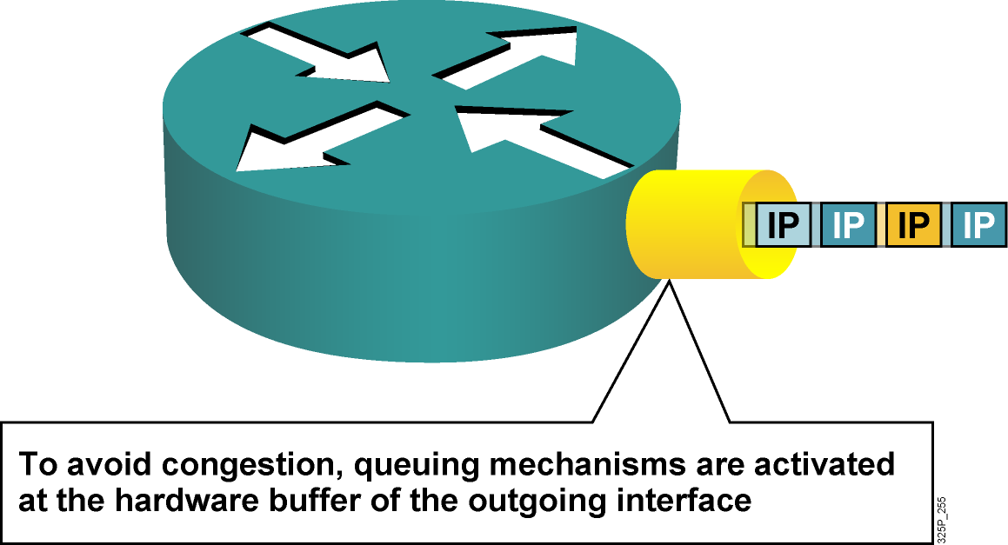
Congestion and Queuing

Slide 42
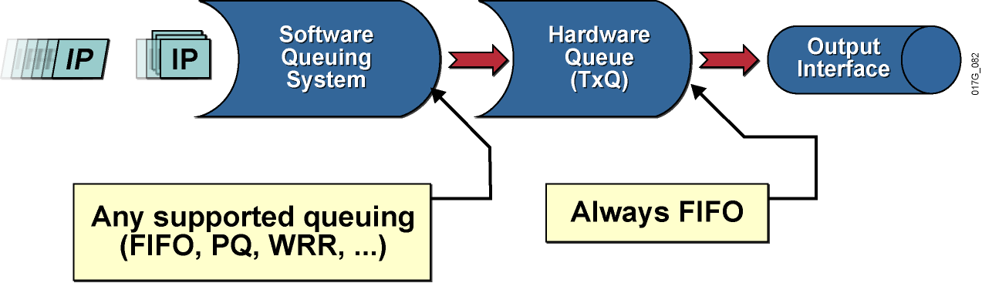
Queuing Algorithms
  First in, first out (FIFO)
  Priority queuing (PQ)
  Round robin
  Weighted Fair Queue.
  Class Based Weighted Fair Queue.

Slide 43
Implement the DiffServ QoS Model
Introducing Traffic Policing and Shaping

Slide 44
Why Use Shaping?
  To prevent and manage congestion in ATM, Frame Relay, and Metro Ethernet networks, where asymmetric bandwidths are used along the traffic path
  To regulate the sending traffic rate to match the subscribed (committed) rate in ATM, Frame Relay, or Metro Ethernet networks
  To implement shaping at the network edge

Slide 45
Why Use Policing?
  To limit access to resources when high-speed access is used but not desired (subrate access)
  To limit the traffic rate of certain applications or traffic classes
  To mark down (recolor) exceeding traffic at Layer 2 or
  Layer 3

Slide 46
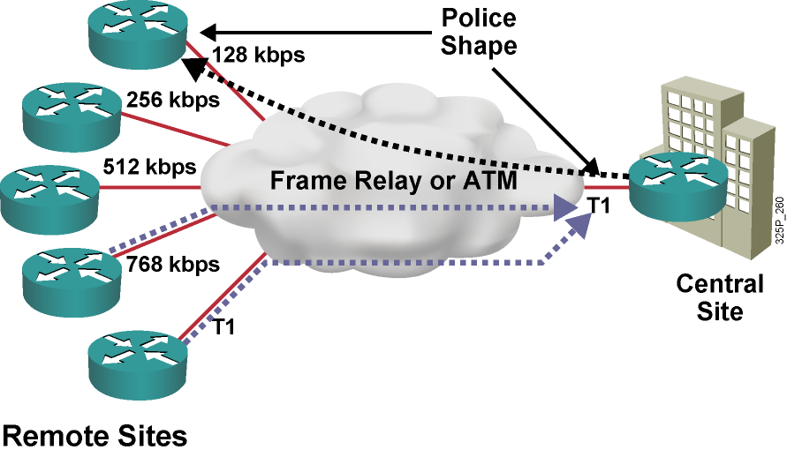
Traffic Policing and Shaping Example
  Central to remote site speed mismatch
  Remote to central site oversubscription
  Both situations result in buffering and in delayed or dropped packets.

Slide 47
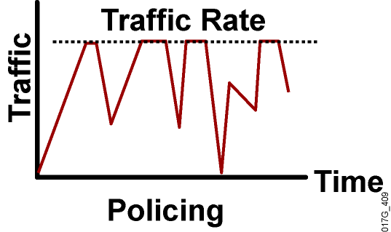
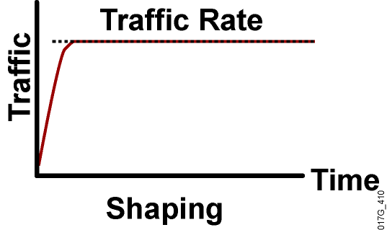
Policing vs. Shaping
  Incoming and outgoing directions.
  Out-of-profile packets are dropped.
  Dropping causes TCP retransmits.
  Policing supports packet marking or
  re-marking.
  Outgoing direction only.
  Out-of-profile packets are queued until a buffer gets full.
  Buffering minimizes TCP retransmits.
  Marking or re-marking not supported.
  Shaping supports interaction with Frame Relay congestion indication.

Slide 48
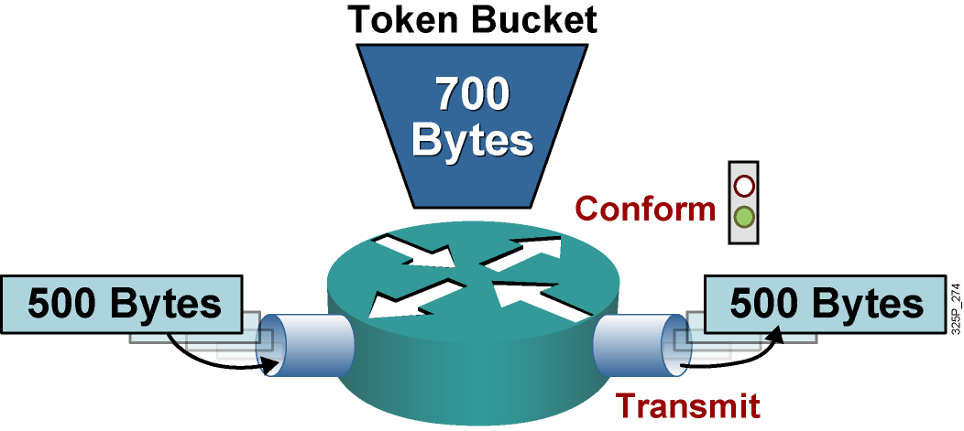
Single Token Bucket
If sufficient tokens are available (conform action):
  Tokens equivalent to the packet size are removed from the bucket.
  The packet is transmitted.

Slide 49
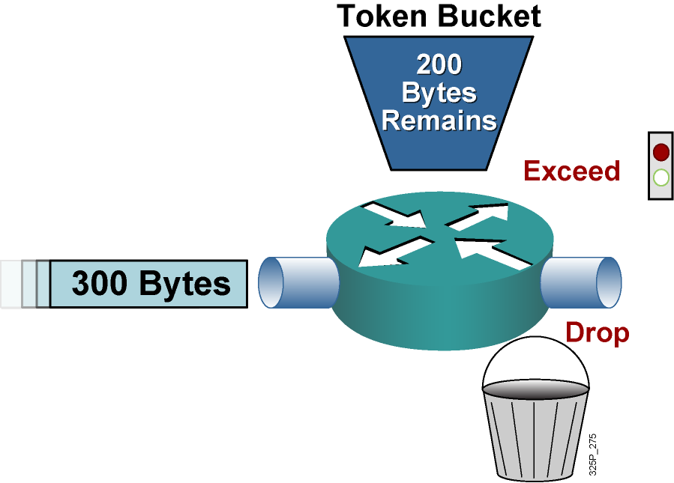
Single Token Bucket (Cont.)
If sufficient tokens are not available (exceed action):
  Drop (or mark) the packet.

Slide 50
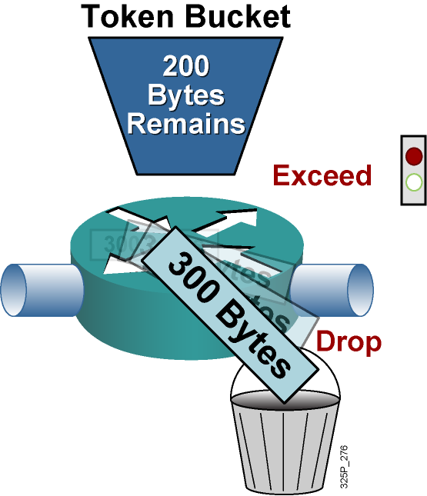
Single Token Bucket (Cont.)
If sufficient tokens are not available (exceed action):
  Drop (or mark) the packet.

Slide 51
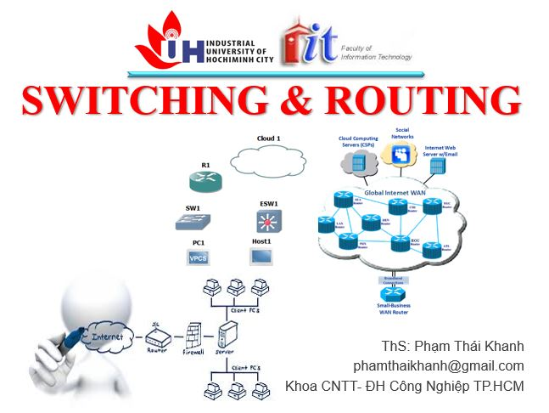


phamthaikhanh@gmail.com
This Photo by Unknown Author is licensed under CC BY-NC

